Slide 1
i4Trust Marketplace
Francisco de la Vega - CTO FICODES

Slide 2
Agenda
Introduction - The Business API Ecosystem GE
BAE Concepts
Catalog models
Ordering models
Usage models
Revenue Sharing models
i4Trust Marketplace
Integration with iShare
i4Trust plugin
Step by Step

Slide 3
Business API Ecosystem

Slide 4
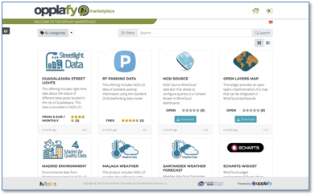
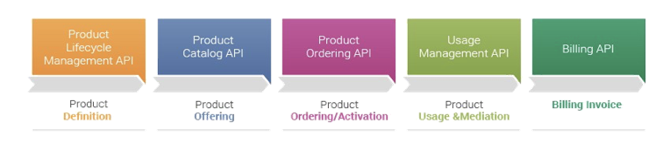
Business API Ecosystem (1 of 6)
Supports the creation of digital marketplaces for the monetization of digital assets
Manages the lifecycle of products offers, from product creation to monetization, billing, payment and revenue sharing
Integrated with Identity Management and Data Usage Policy Management frameworks
Relying on TM Forum Business Ecosystem Open APIs

Slide 5
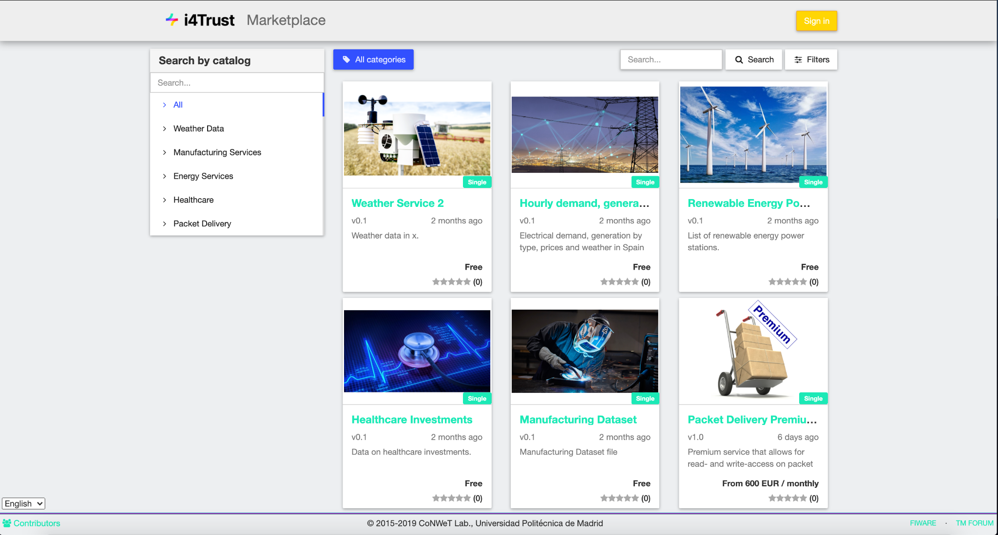
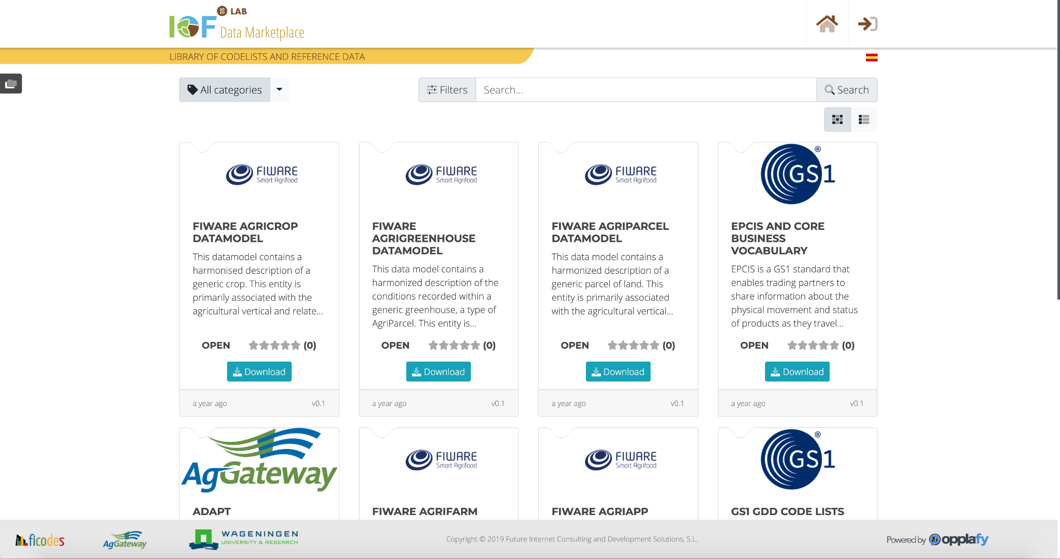
Business API Ecosystem (2 of 6)
Customizable
Branding and theming support
Multiple identity providers supported, including FIWARE Keyrock, Keycloak and GitHub

Slide 6
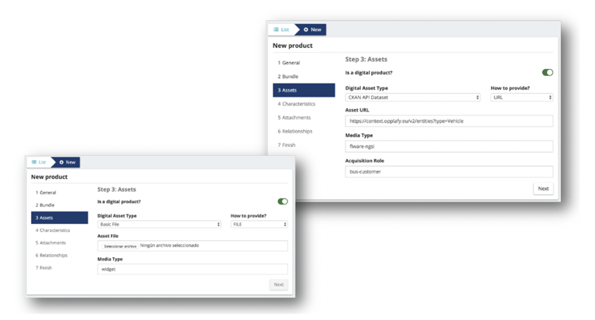
Business API Ecosystem (3 of 6)
Support for digital asset monetization, including (but not limited to) data
Even regarding data, multiple types:
Files
Right-time NGSI queries
Data streams
Media streams
...

Slide 7
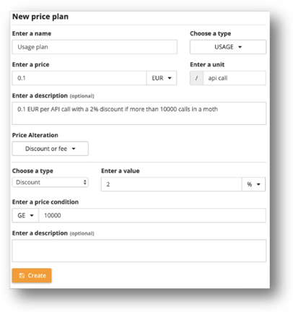
Business API Ecosystem (4 of 6)
Multiple Price models:
Open / Free
One time payments
Subscriptions
Pay-per-use
Advanced models:
Fees
Discounts
Dynamic pricing

Slide 8
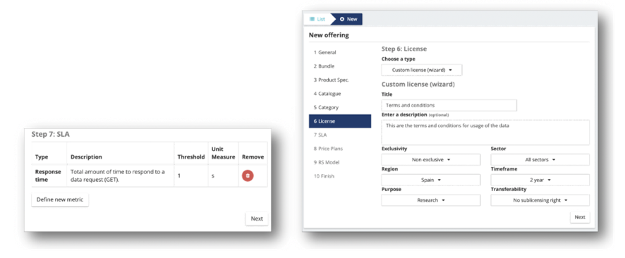
Business API Ecosystem (5 of 6)
Support for usage terms and conditions and data-specific licenses
Support for specifying SLAs

Slide 9
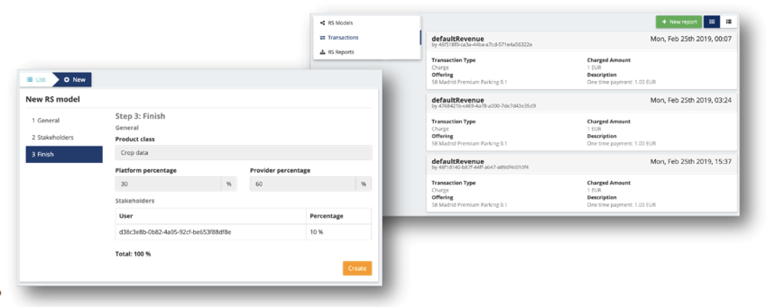
Business API Ecosystem (6 of 6)
Support for revenue sharing models

Slide 10
BAE Concepts

Slide 11
Catalog Elements
Catalog Models taken from TMForum Catalog Management API v14.5
Product classification
Category: Created by a system administrator, can be used by providers to categorize offers. Categories can be nested to create a tree
Catalog: Created by providers to group their own offers. All offers of the system need to be part of a Catalog.

Slide 12
Catalog Elements
Catalog Models taken from TMForum Catalog Management API v14.5
Product creation
Asset: Real digital product registered in the system (the data, file, service, etc).
Product Specification: Definition of product-related information linked to the asset in the system. It incorporates asset link, product characteristics, and attachments.
Product Offering: Definition of the business-related information linked to the product. It includes link to the catalog, product specification, licence, SLAs, pricing models and revenue sharing models.

Slide 13
Ordering Elements
Ordering Models taken from TMForum Ordering and Inventory Management API v14.5
Models:
Order: Defines the acquisition of a couple of product offering, including customer, billing profile, provider and acquired offerings, .
Product: Defines an acquired product. It includes, the chosen pricing model, the chosen characteristics, and the list of charges made by the customer

Slide 14
Usage Elements
Usage Models taken from TMForum Usage Management API v14.5
Models:
Usage Specification: Defines the kind of usage information expected for a given product offering, including the units and metrics.
Usage Document: Includes an actual usage made of a product specification asset during a period of time. It includes also its associated price and whether it has been charged or not.

Slide 15
Revenue Sharing
Models:
Revenue Sharing Model: It establishes how the incomes generated by a set of offers has to be distributed among the different stakeholders involved. It includes, the platform percentage, the provider percentage and the stakeholders percentage.
Transaction: A payment made by a customers linked to a particular revenue sharing model.
Revenue Sharing Report: Result of applying the a revenue sharing model to its linked transactions. It include the amount to be paid to the different stakeholders.

Slide 16
i4Trust Marketplace

Slide 17
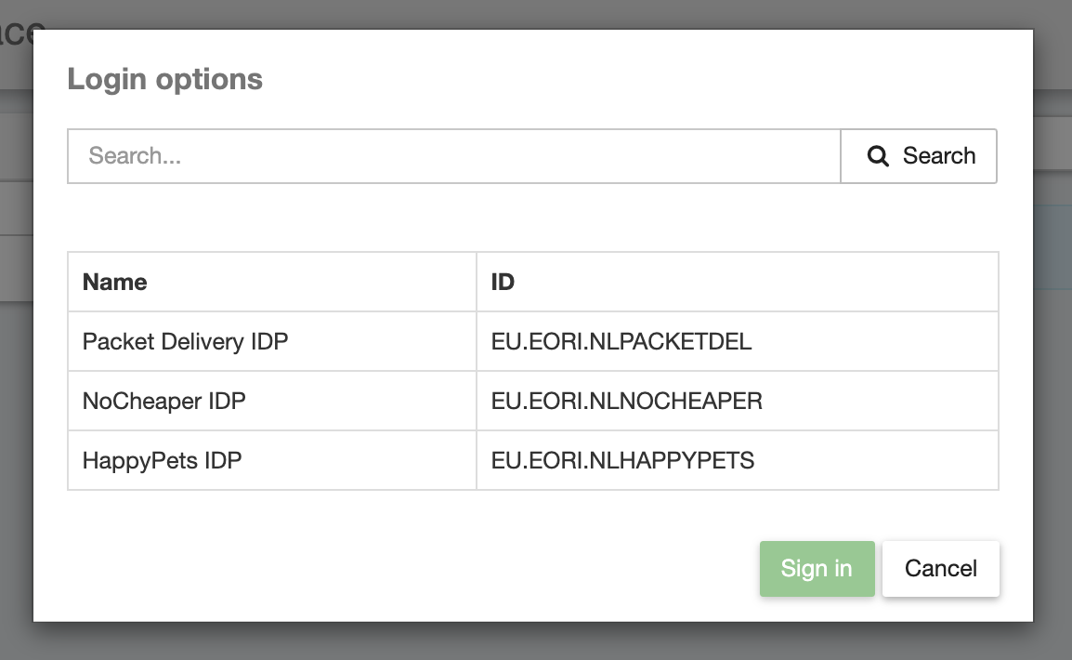
iSHARE Integration
i4Trust Marketplace is a global instance offered to all participant organization.
It supports multiple IDPs thanks to iShare protocol, so providers and customers can sign in using its own IDP.
Each data provider organization is owning its own IDP, API Umbrella and Context Broker
iShare JWT are used to authenticate the Marketplace in the different IDPs and retrieve user profiles.

Slide 18
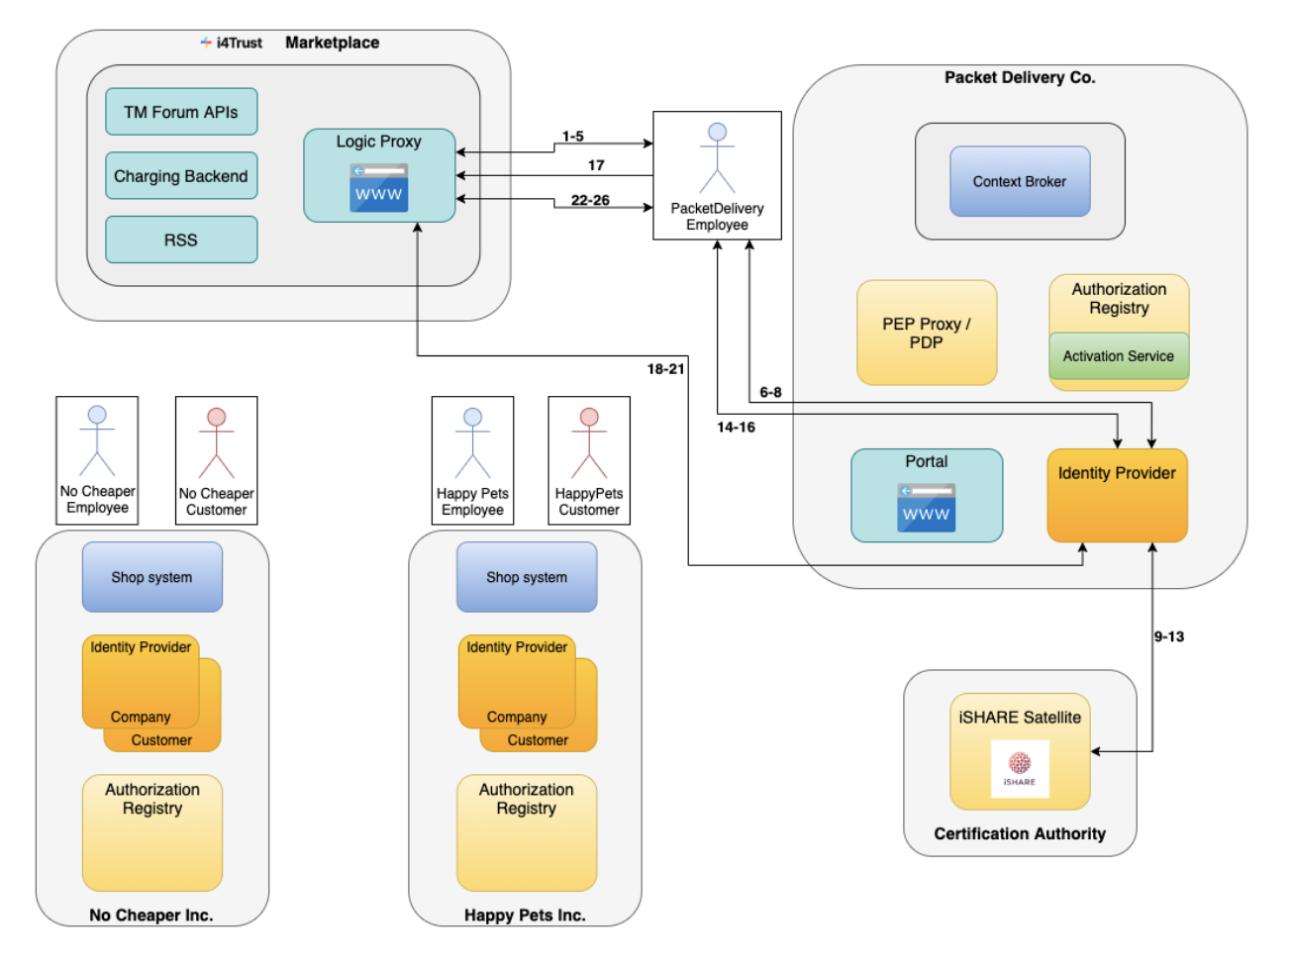
iSHARE Integration

Slide 19
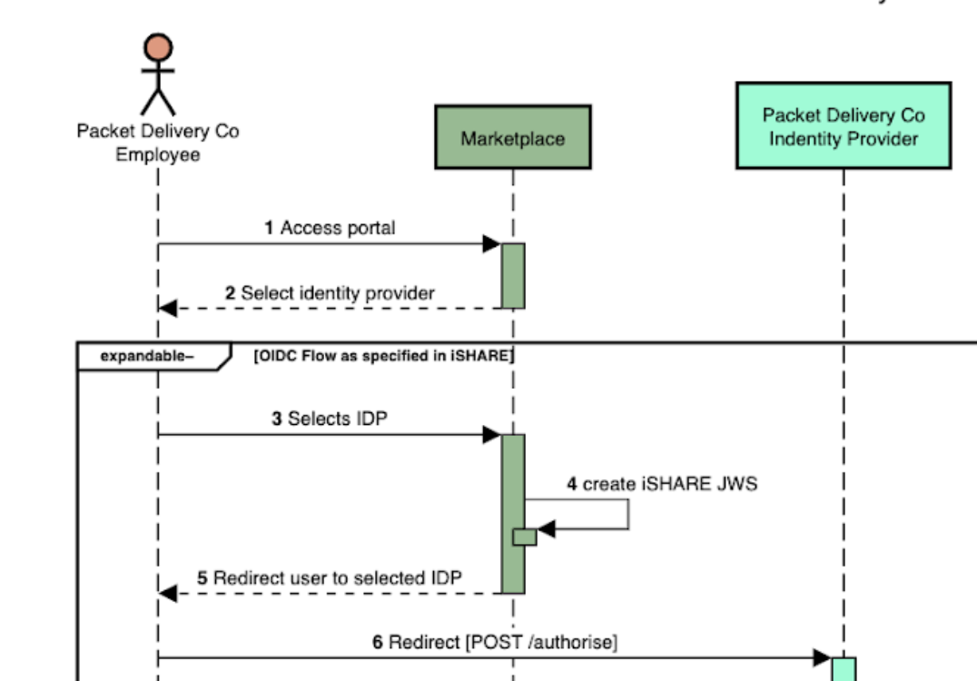
iSHARE Integration
The user selects its IDP in the list the Marketplace has in its system
Once the user selects its IDP, the Marketplace builds its iShare JWT and submits it to the IDP to authenticate itself.

Slide 20
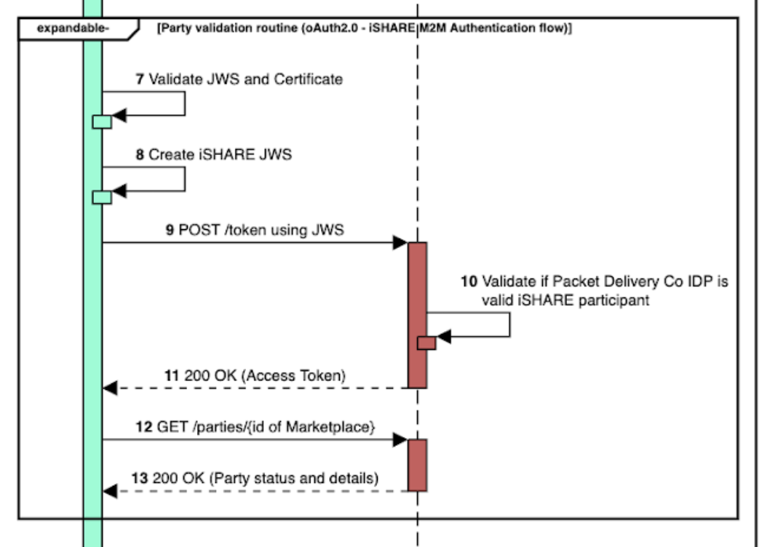
iSHARE Integration
The selected IDP validates and decodes the Marketplace JWT.
the selected IDP build its own JWT and validates the Marketplace as a participant in the iShare Satellite.

Slide 21
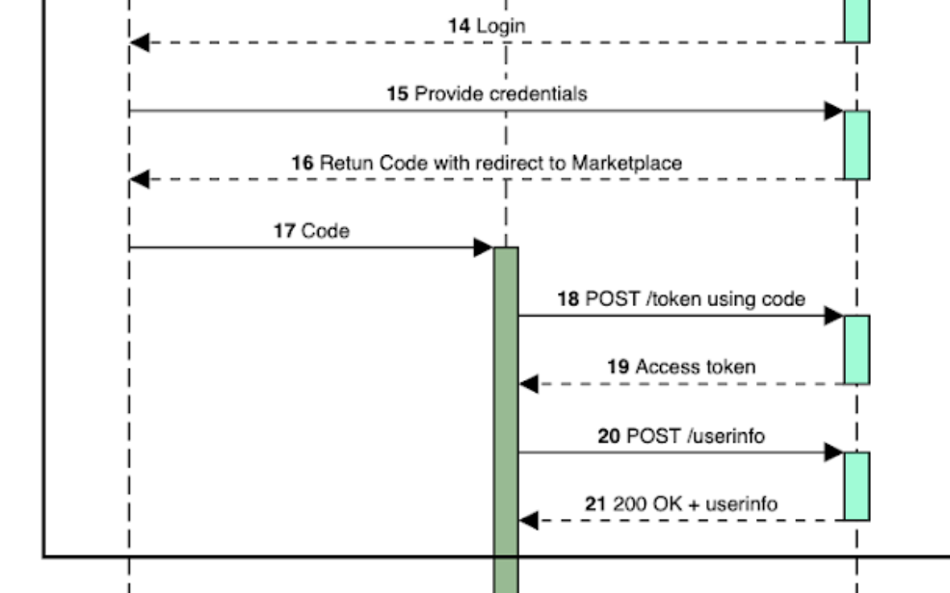
iSHARE Integration
The IDP returns to the Marketplace the login endpoint
The Marketplace redirects user browser to the login endpoint so the user can authenticate itself in its own IDP.
Once the user is authenticated, OIDC is used to get a user access token and user profile in the Marketplace.

Slide 22
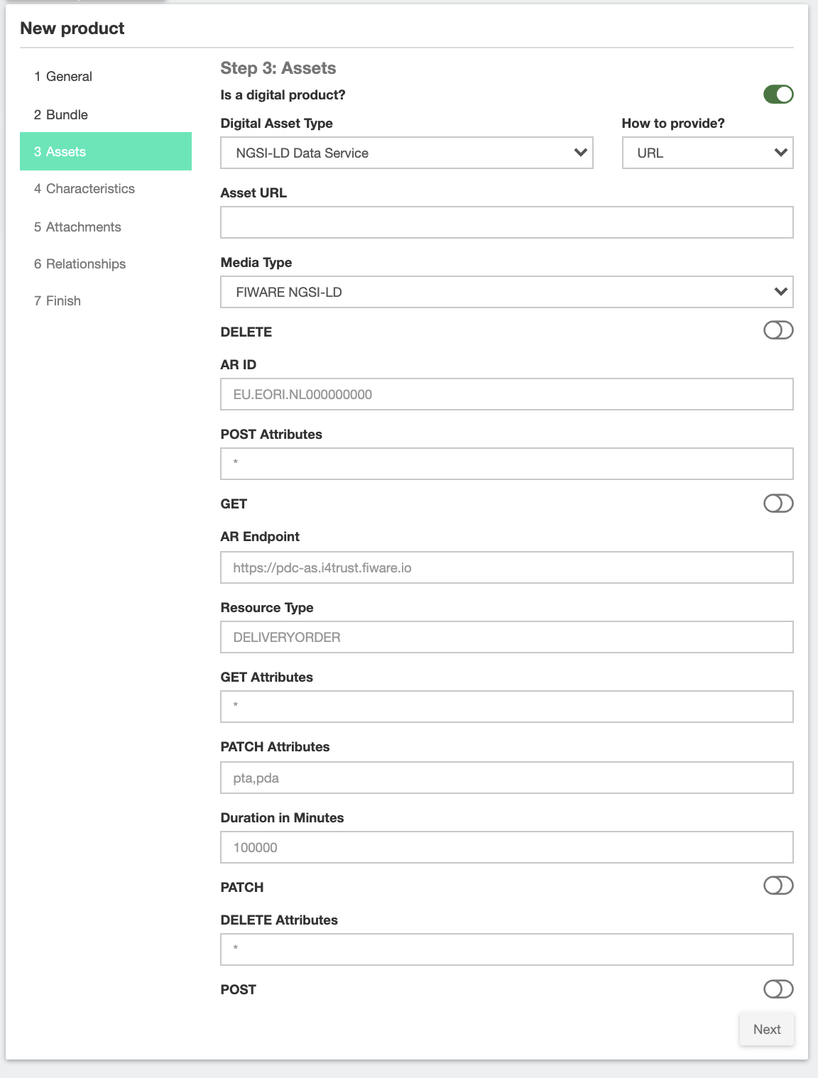
i4Trust plugin
A new asset plugin has been developed for registering data offered by a participant Context Broker.
It allows to provide metadata representing the policy that is going to be applied to customers.
Context Broker URL
Entity to be monetized
Attributes that can be GET
Attributes that can be POST
Attributes that can be PATCH
Attributes that can be DELETED
Duration of the policy

Slide 23
i4Trust plugin
When a new product is created:
Provided metadata is validated
Relevant info is attached as product characteristics
When the offering is acquired
The Marketplace builds an iShare JWT and authenticates itself using client_credentials grant to get an access token for data owner organization Authorization Registry.
The Marketplace creates a new policy (delegationEvidence) using the metadata of the product and the identity of the buyer organization.
The Marketplace submits the policy to the AR of the data owner using its access token.

Slide 24
Step by Step

Slide 25
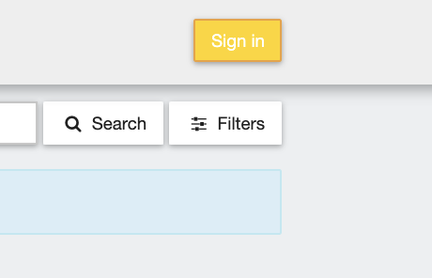
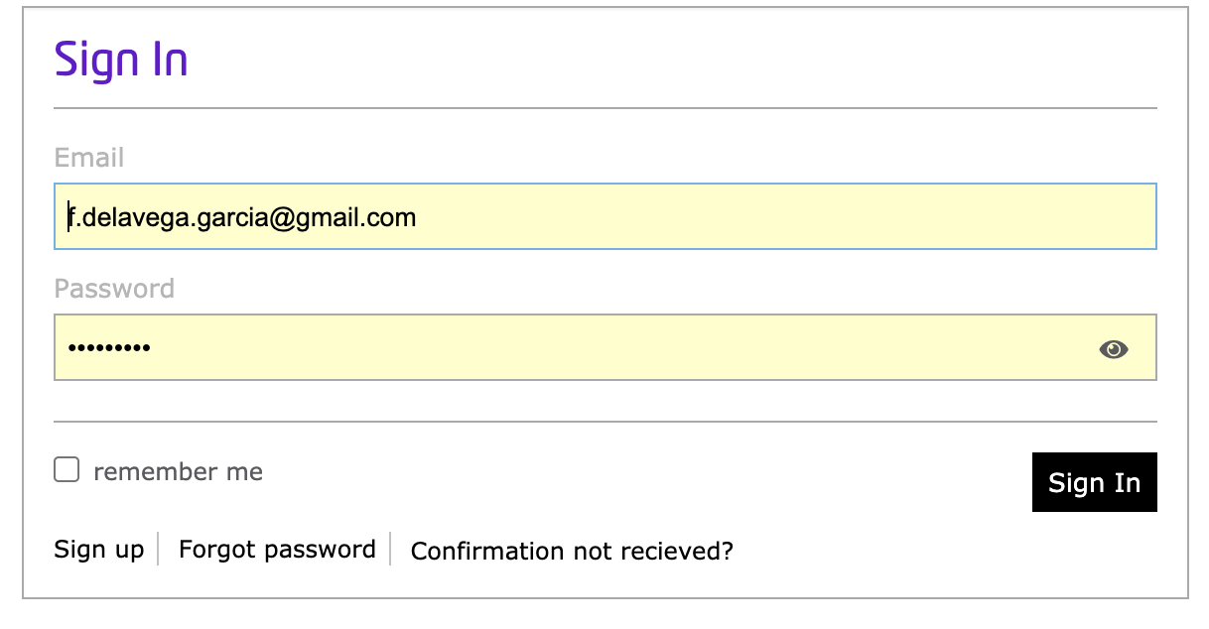
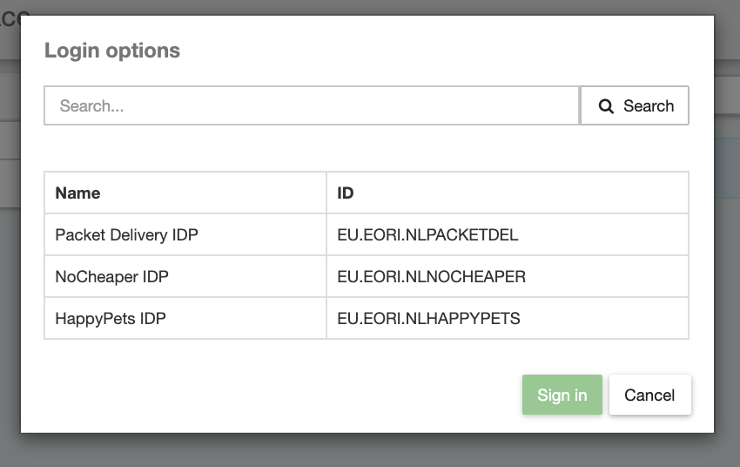
Step by Step
Access to the Marketplace
The sign in option allows to select the IDP between the registered in the Marketplace.
Select your IDP and click on Sign in, you will be prompted to your IDP login page.

Slide 26
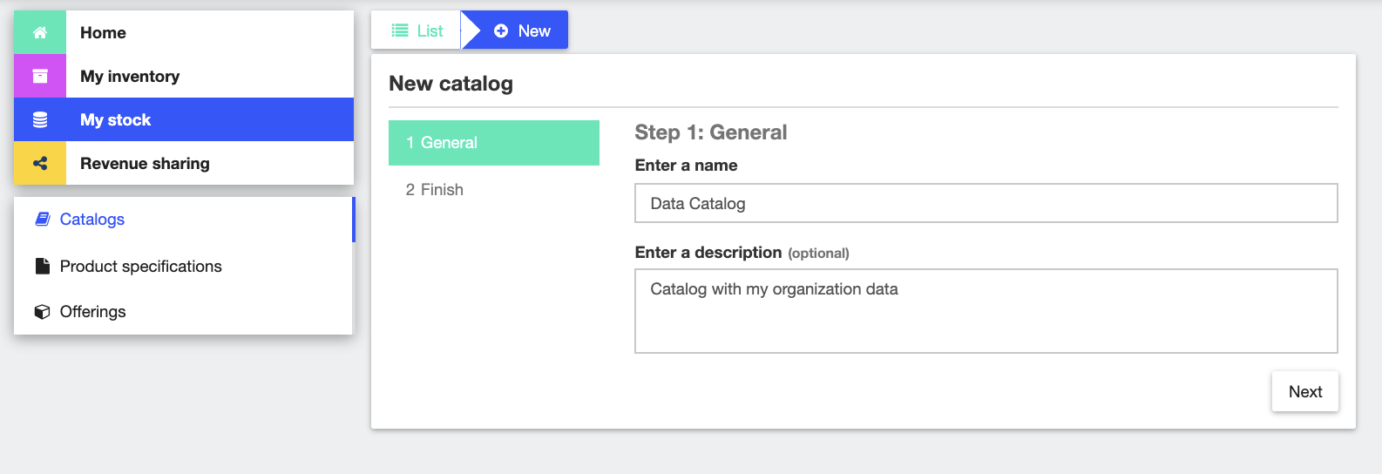
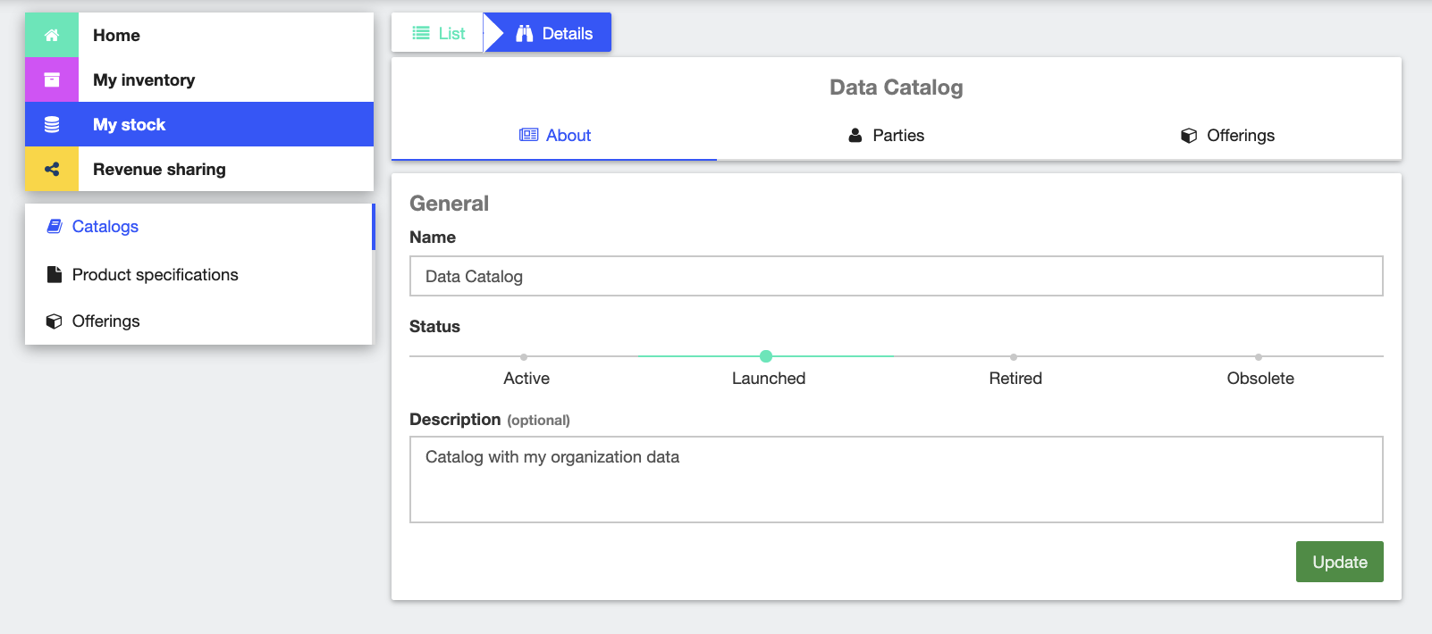
Step by Step
Access My Stock section
Create a new Catalog providing a name and a description.
Catalogs are created in Active state, to make the catalog available to customers its status needs to be changed to Launched.

Slide 27
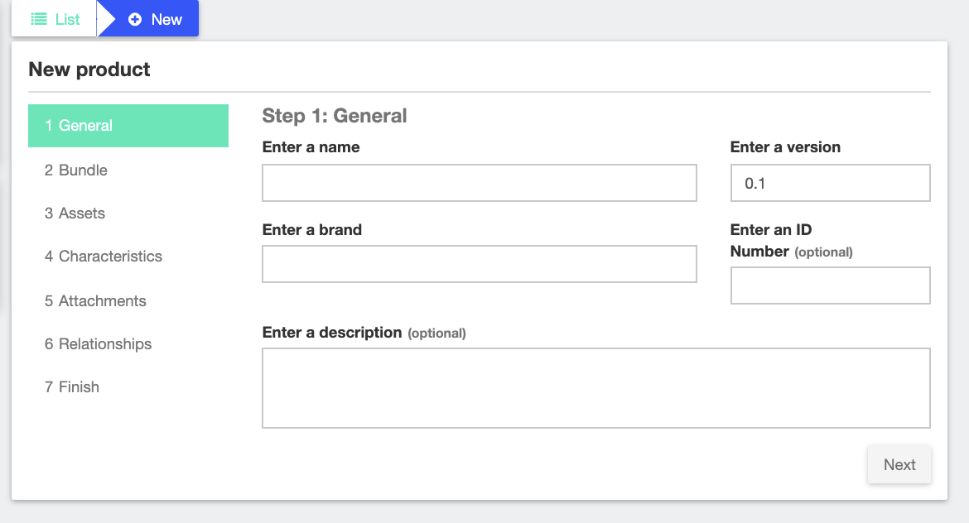
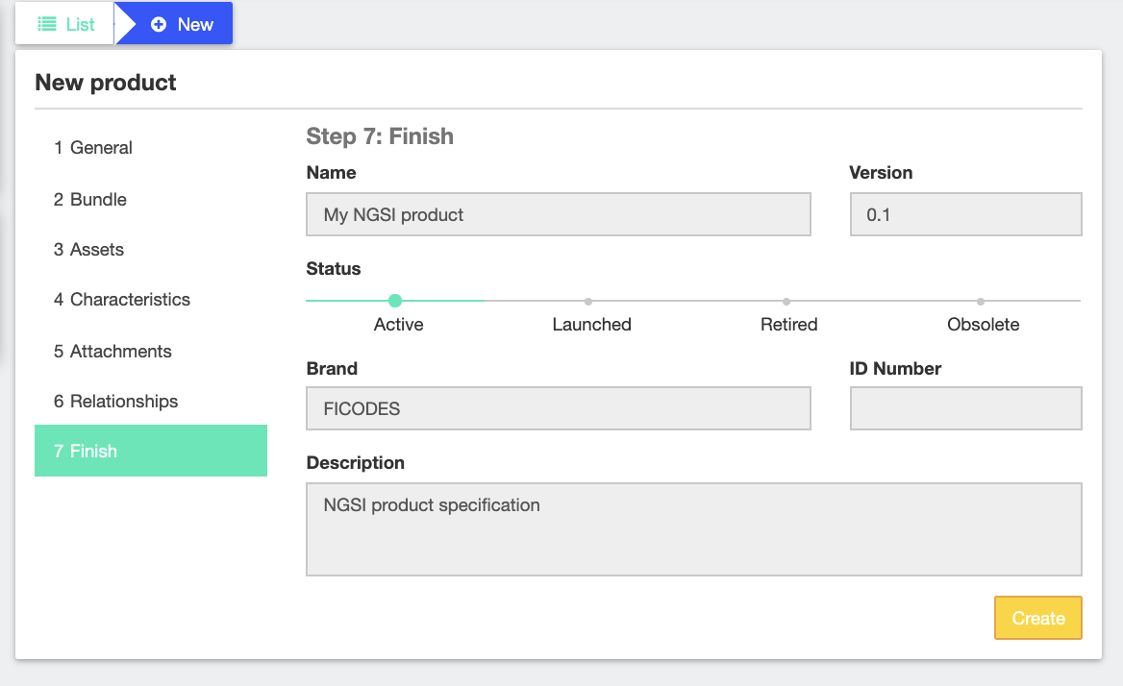
Step by Step
Access to Product Specification section
Click on New to open Product Spec. Form
Fill basic product information including name and description.
In Asset section, select the kind of asset you are creating and fill the requested metadata.
In attachment section provide the image for the product and any optional attachment, such as documentation.
Product Specs. are created in Active state, to make them available change the state to Launched.

Slide 28
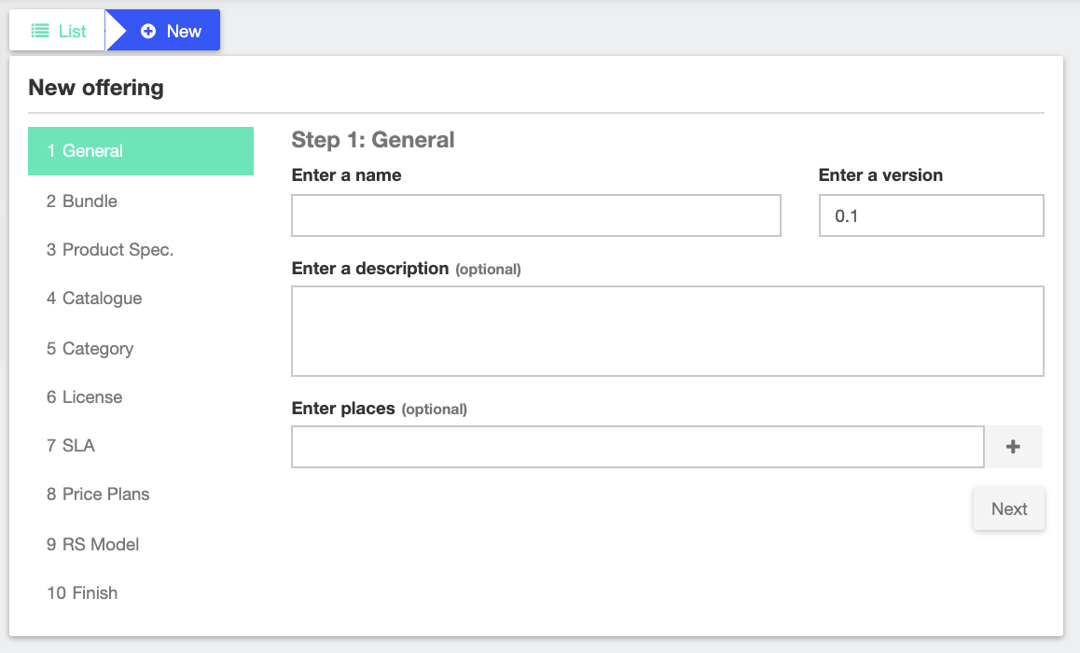
Step by Step
Access to Product Offerings section.
Click on new to open Product Offering form.
Fill basic offering information including the name and the description.
Select the catalog where the offering is going to be published and select the categories.
Provide licence, and SLAs
Provide pricing model and revenue sharing model.
Create the offering. Offerings are created in Active state, to make them available change the state to Launched.

